Slide 1



Slide 2
CUSTOMIZED ONLINE
EXAMINATION SYSTEM
R. Saikumar
Reg No:321228820101
V. SATISH
Assistant Professor

Slide 3
CUSTOMIZED ONLINE
EXAMINATION SYSTEM
R. Saikumar V. SATISH
Reg No:321228820101 Assistant Professor

Slide 4
abstract
COES is a Web Application to conduct exams ( Mcq , Voice,
Fill-In-The-Blanks) within seconds in Customized Time
limit and Give the Result immediately to Mail.

Slide 5
Problem statement
Suppose If we want to Prepare Our Students for a Job interview or Competitive Exam but, we need search some website related to that Exam or Job.
So, Try to analyze how much effort we keep on just searching for website needed for just 1 hour and 45 minutes.
Some times we may be feel system is overloaded because that is competitive exam most of people will prepare.
So we have less chance to prepare our students to get good score.
The what is the solution for this.

Slide 6
Existing system

Slide 7
Existing system

Slide 8
Proposed system
There are three Kind of users in our Application.
ADMIN: Power remove the Users and Tutor credentials and can prepare and test the exams.
TUTORS: Power to Make Exams for the users.
USERS: Only can write exams and view results.

Slide 9
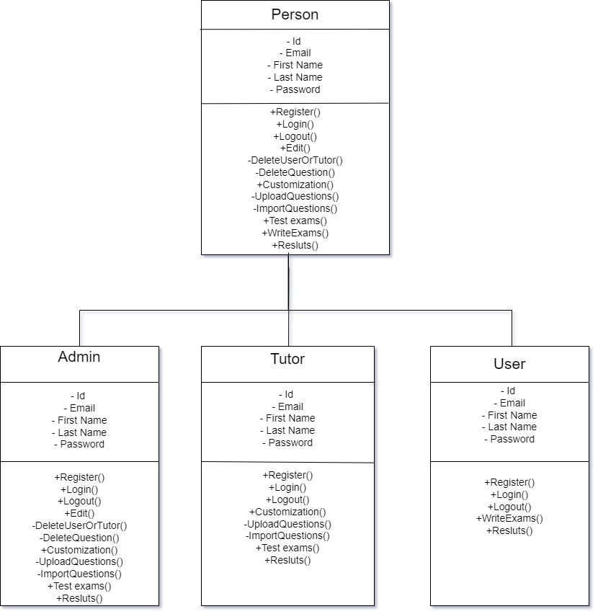

Slide 12
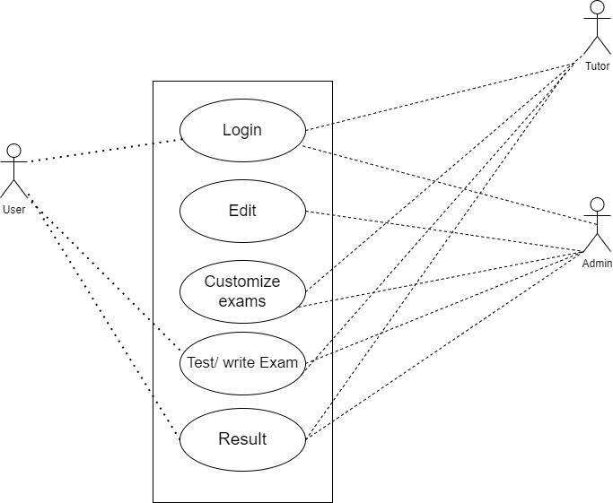

Slide 13
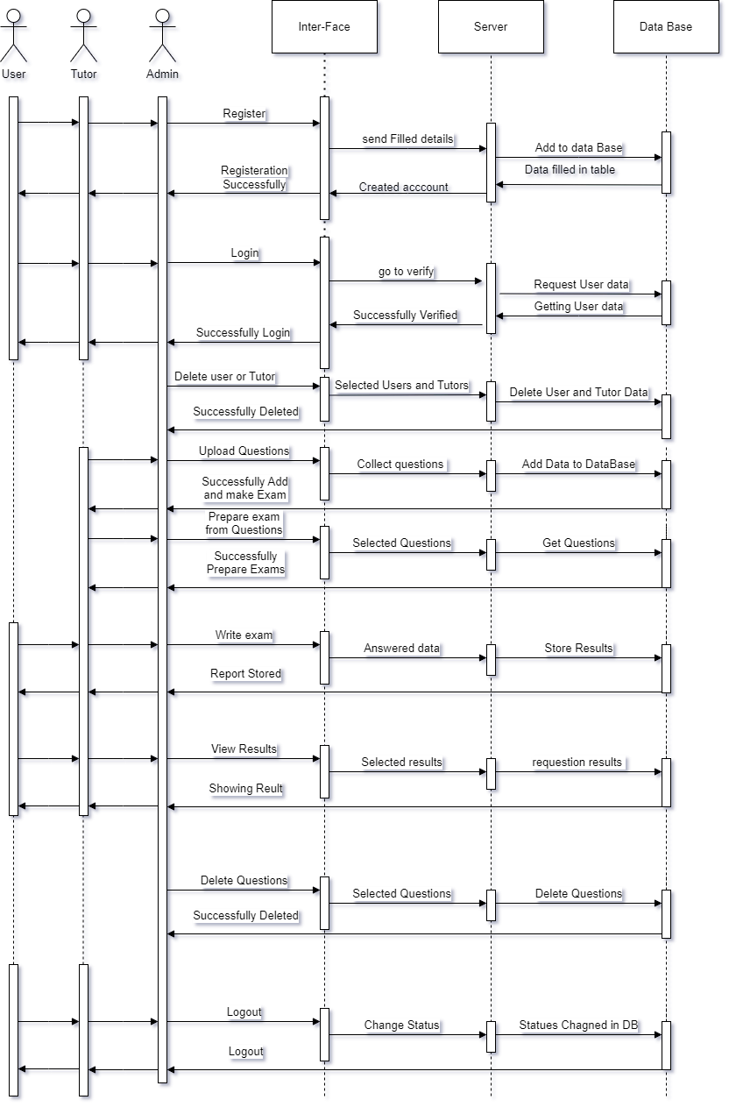

Slide 16
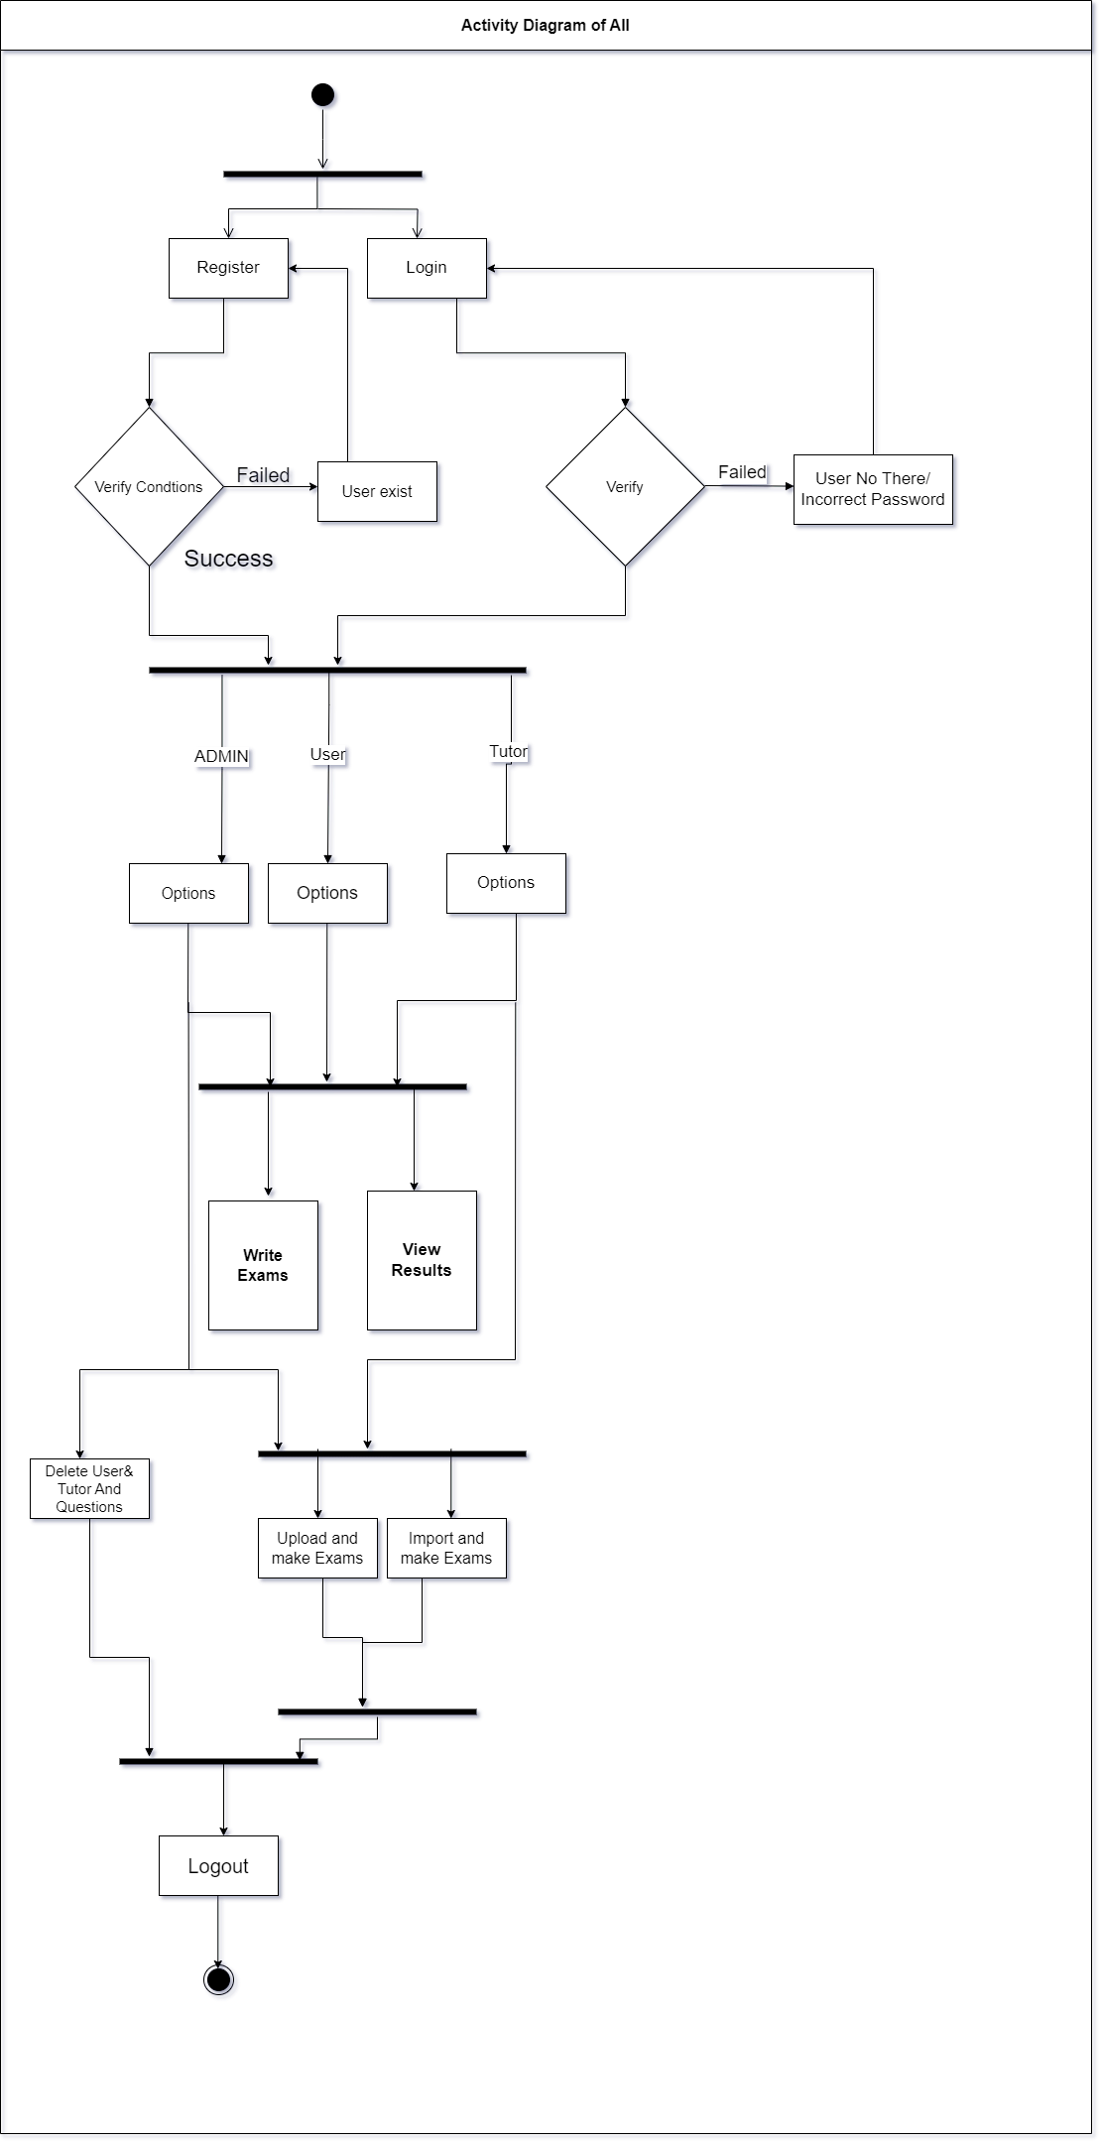

Slide 18
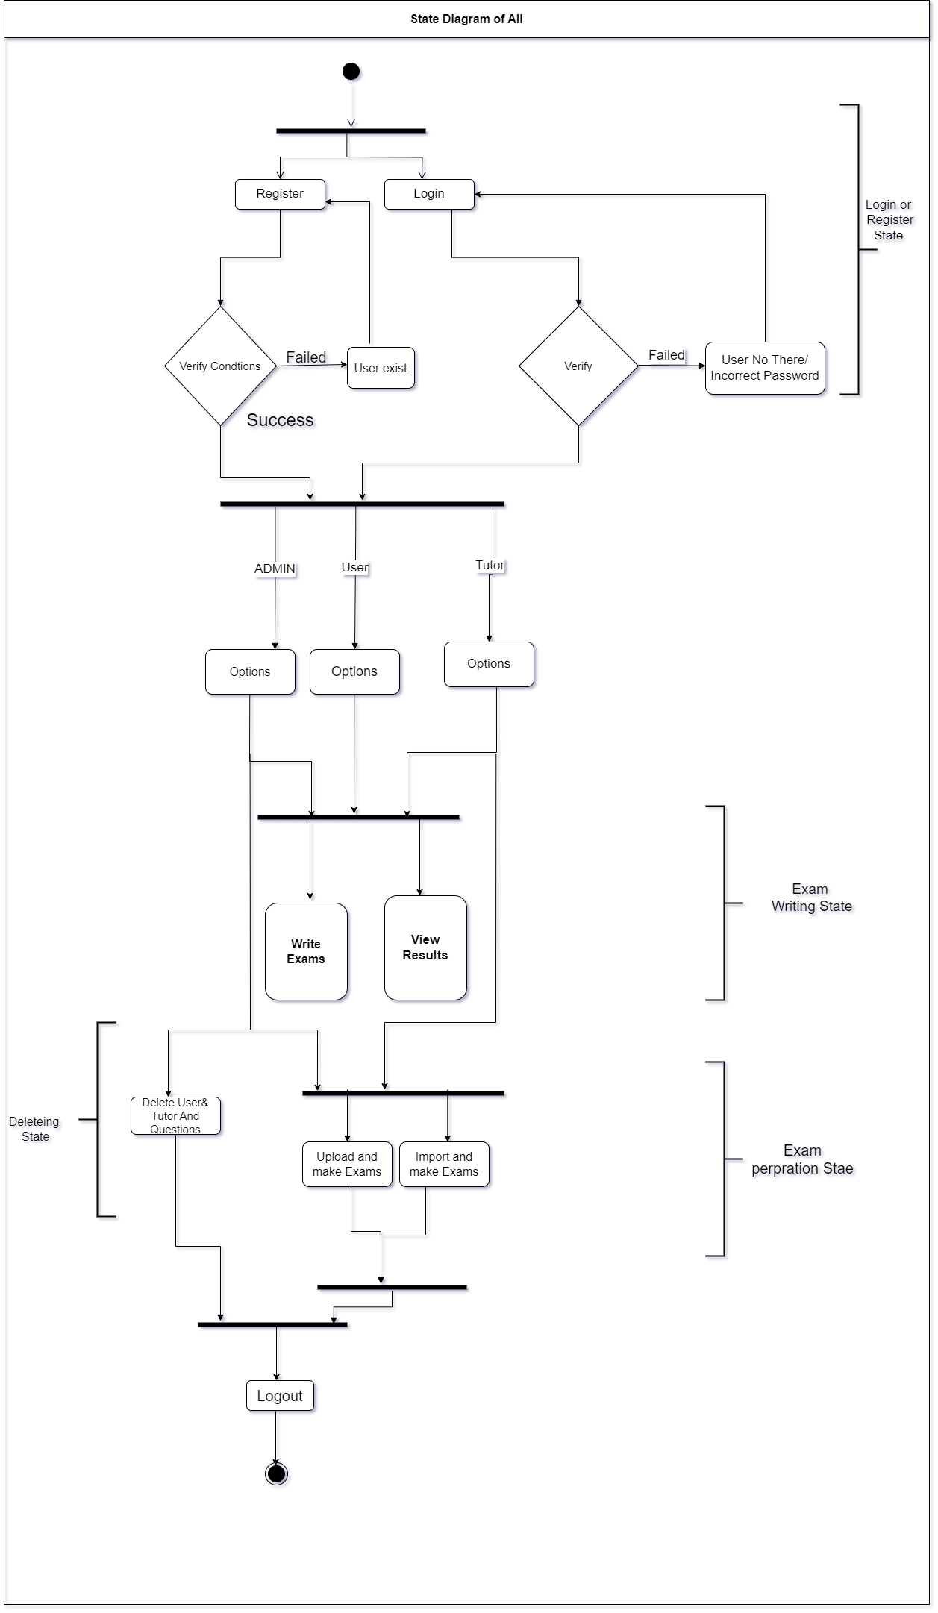

Slide 20
USER TABLE
Id | Types | Email | First Name | Last Name | Password hashed
1 | Admin | saikumap@gmail.com | Sai | Kumar | dfsdkfdsbfkdsbfdskhfsdfskdbksdb
2 | Tutor | rokkam200@gmail.com | Ravi | Rokkam | Kjdkdsdfbdskfldsbks fldsbfksdl fbdsfsd fb
3 | student | Mansa@gmail.com | Mansa | All Ivalu | Dbsdhbfsdf dsbfdsbfjdsbj dsjbsdj

Slide 21
EXAMTABLE
User id | Name | Type | Total | Marks
1 | Math’s | MCQ | 30 | 28
3 | Math’s | MCQ | 30 | 28
2 | Math’s | MCQ | 30 | 29
CURRENT EXAM TABLE
User Id | E-name | Types | Hours | Minutes | Seconds
2 | English | Voice | 00 | 30 | 00
1 | Math’s | MCQ | 01 | 00 | 00

Slide 22
Voice-Table
Fill In TABLE
Id | Subject | Question
1 | English | Writing is good habbit
2 | English | Wait for success
Id | subject | Question | Ans
1 | English | Meaning of Forum | Conference
2 | English | Meaning of Locus | Center
MCQ-Table
Id | Subject | Question | Opt1 | Opt2 | Opt3 | Opt4 | Main
1 | Reasoning | 2,4,8,16, _ | 32 | 63 | 31 | 64 | 32
2 | Reasoning | 5,10,20,40. _ | 80 | 90 | 60 | 50 | 80

Slide 23
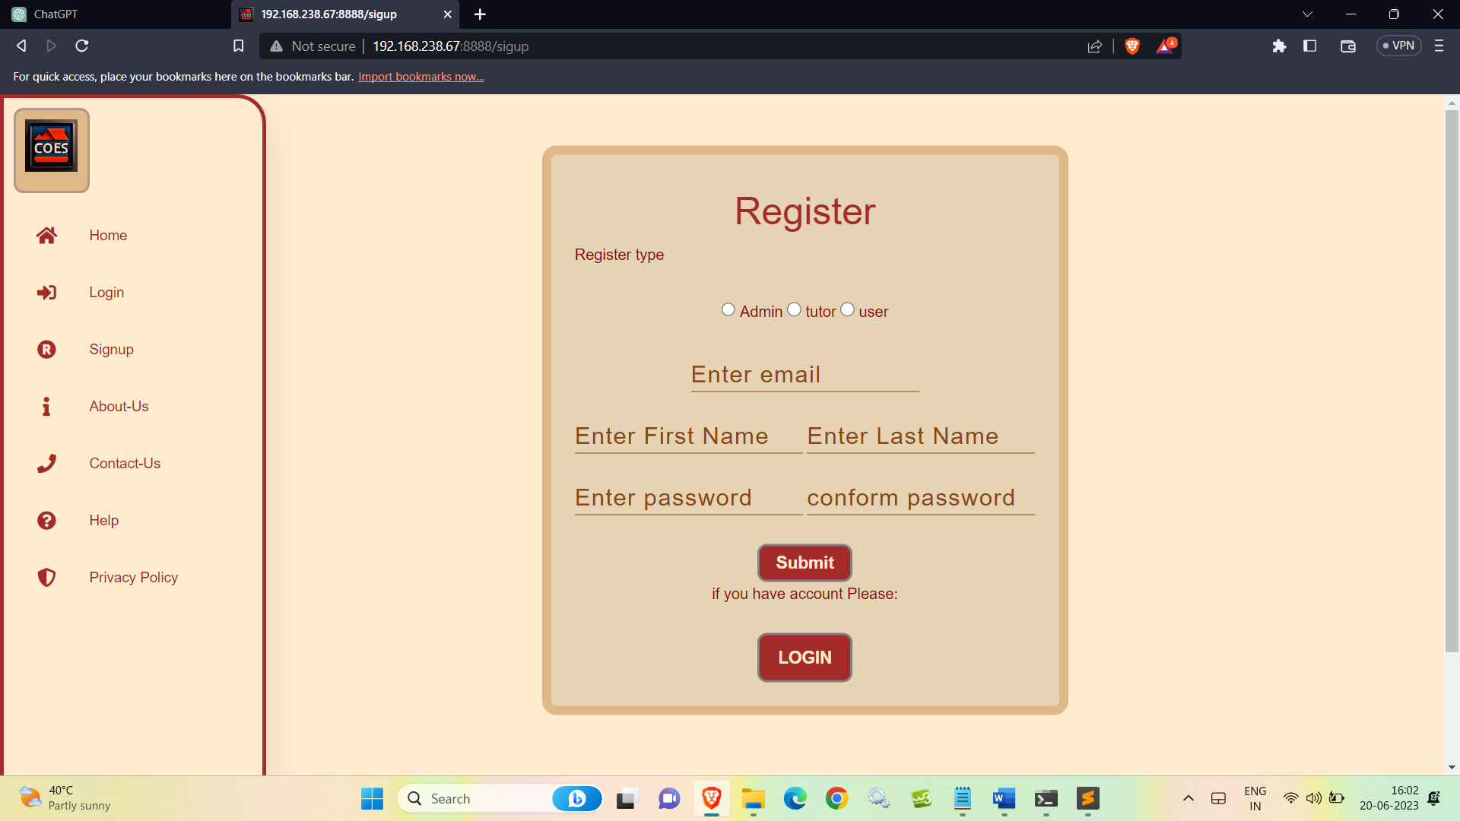

Slide 24
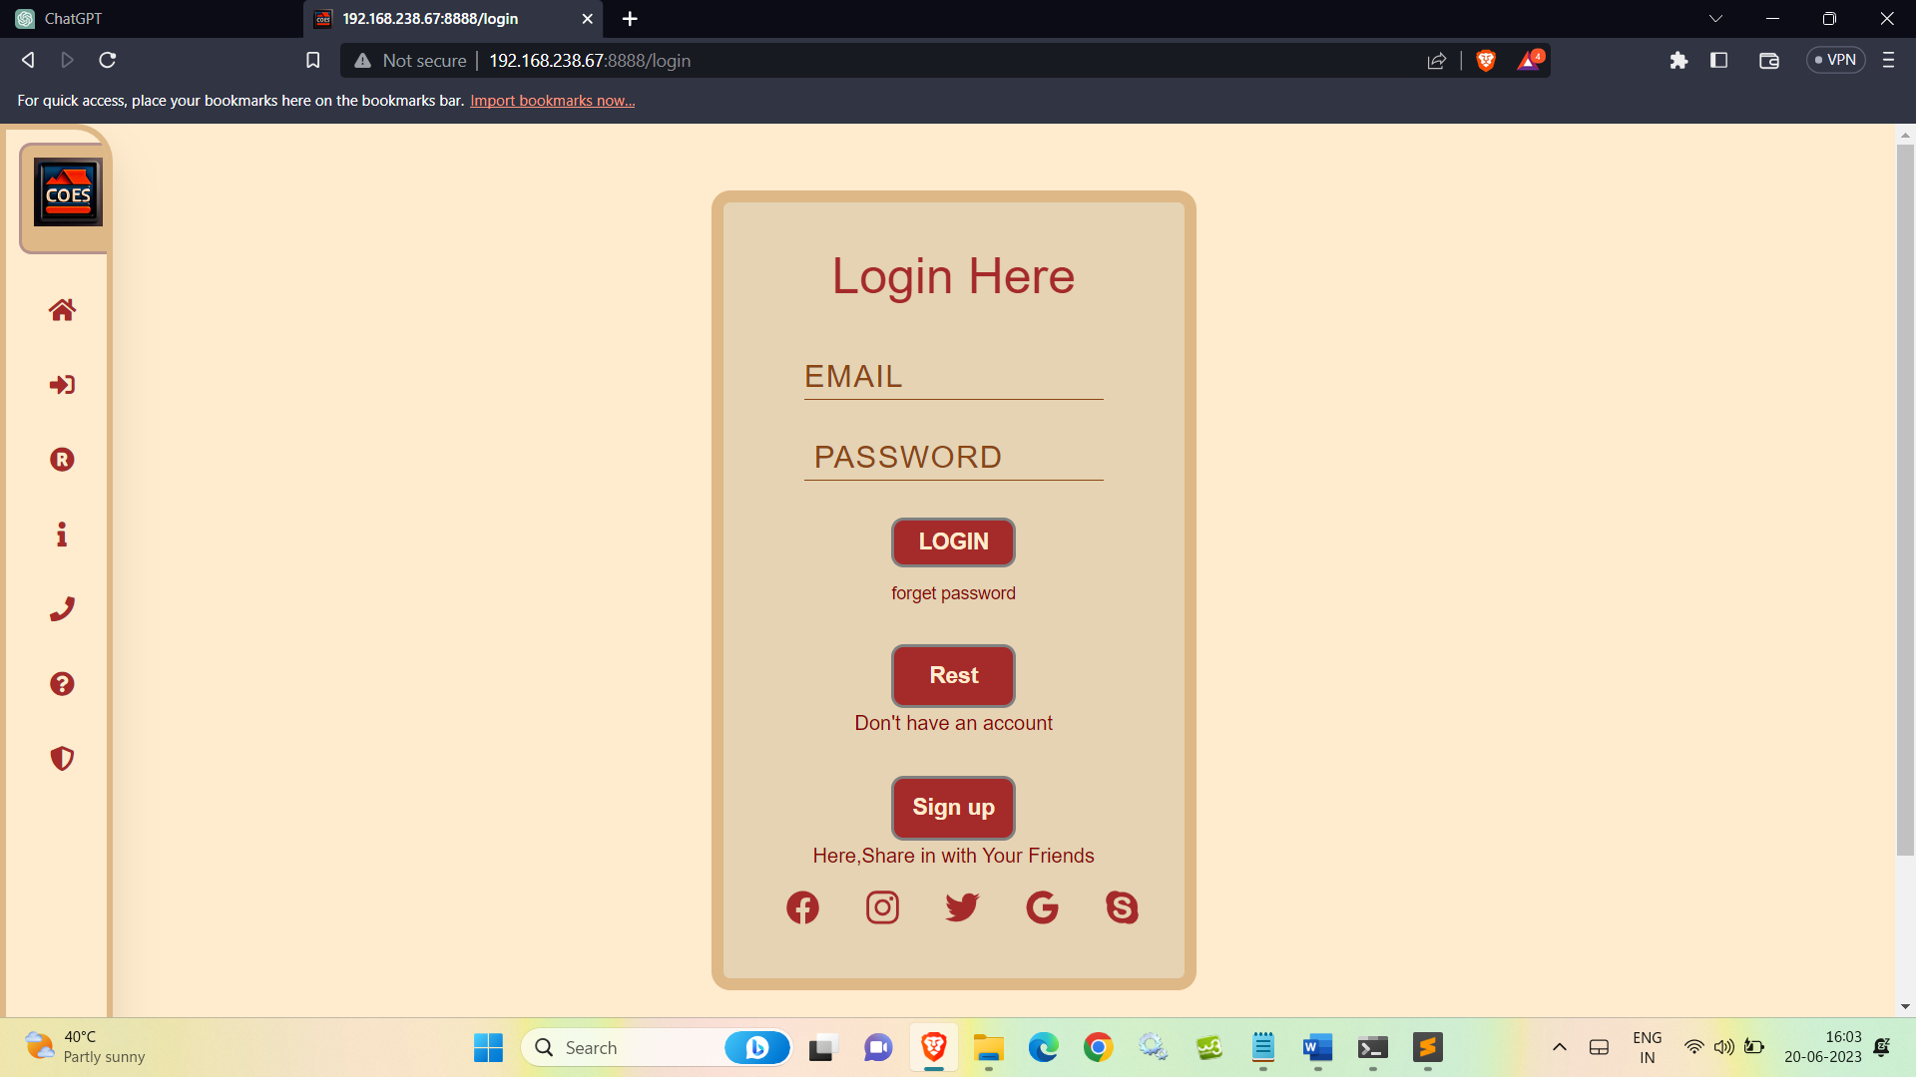

Slide 25
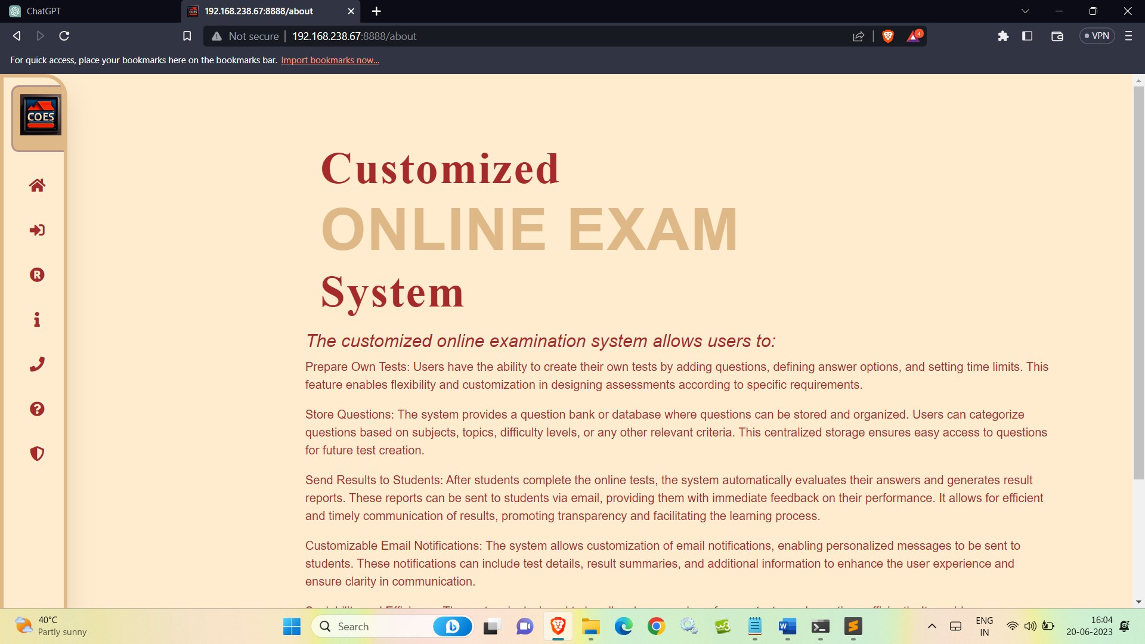

Slide 26
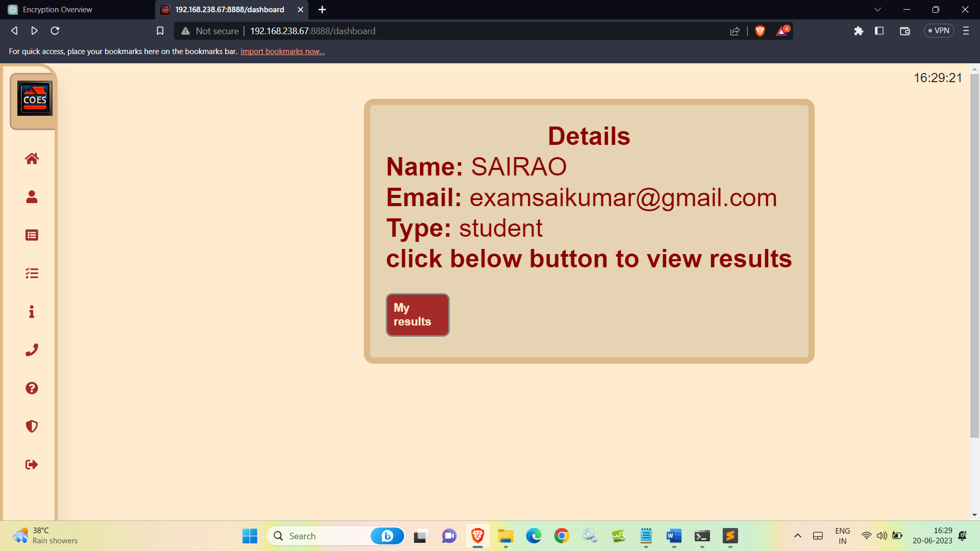

Slide 27
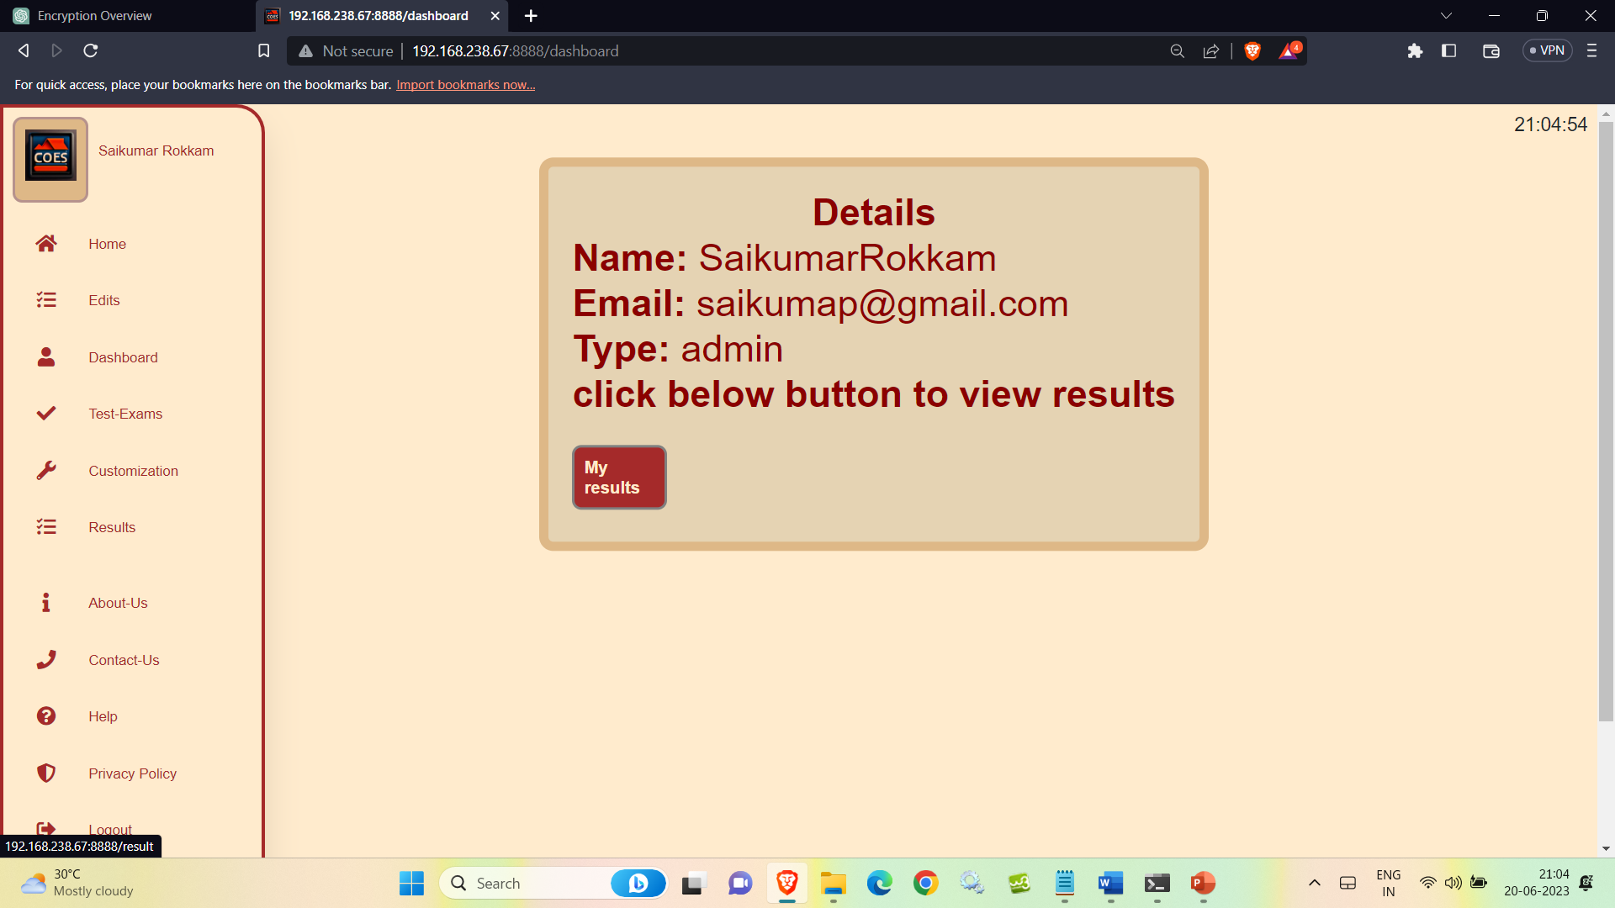

Slide 28
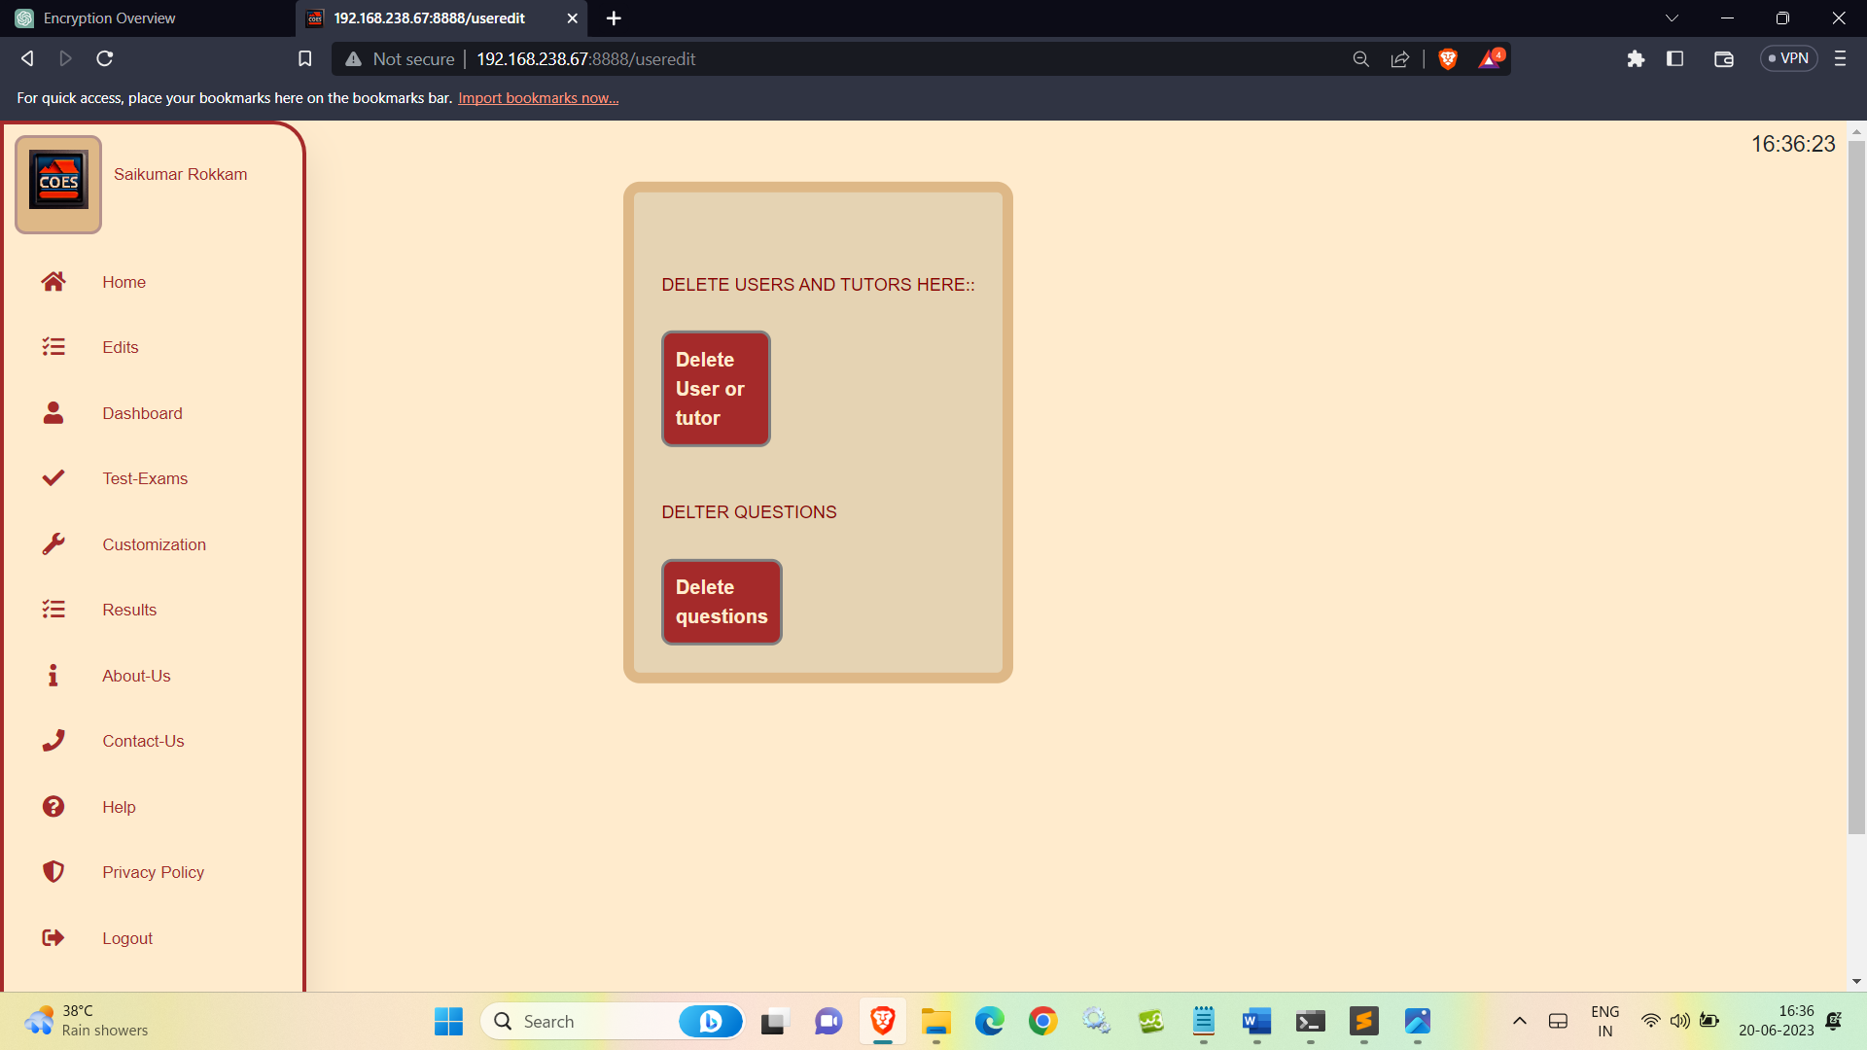

Slide 29
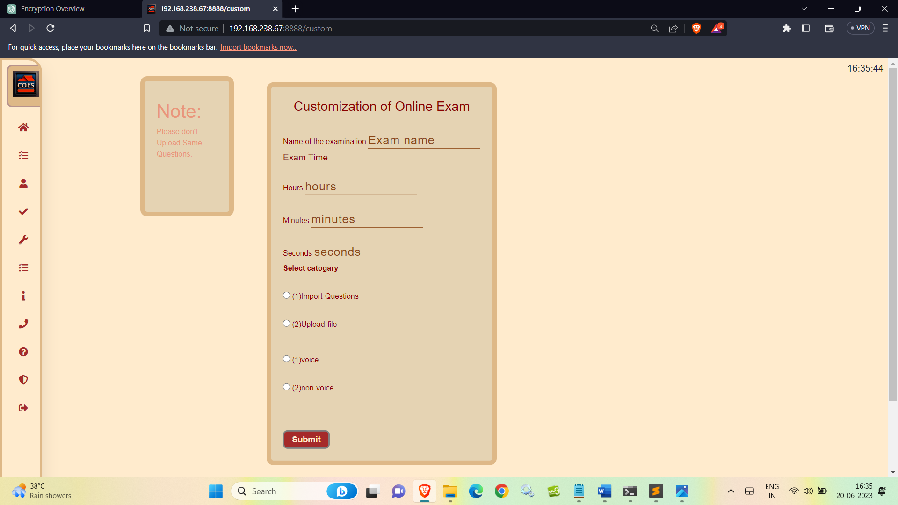

Slide 30
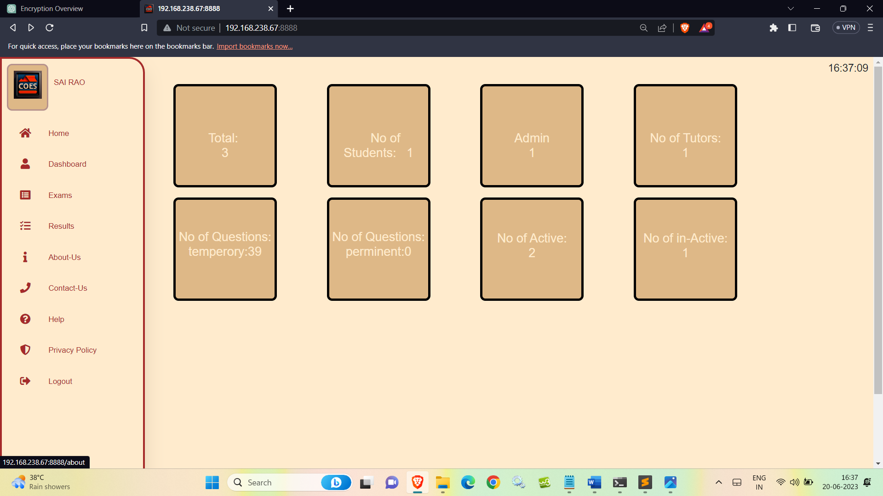

Slide 31
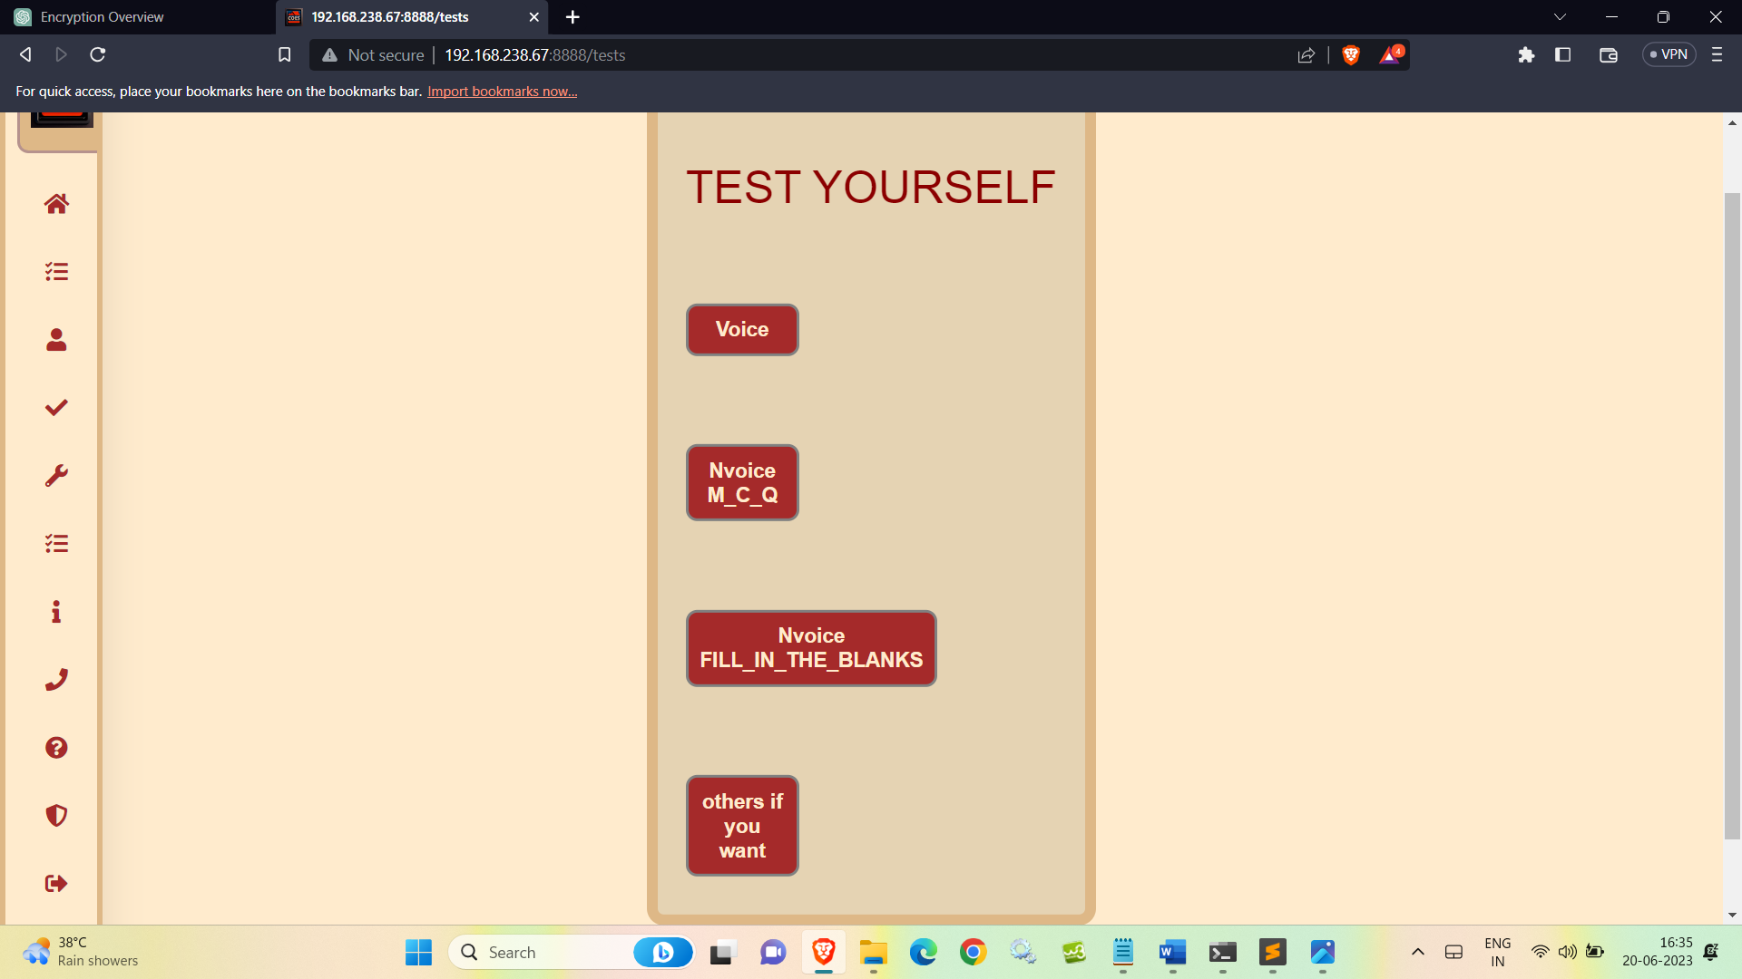

Slide 32
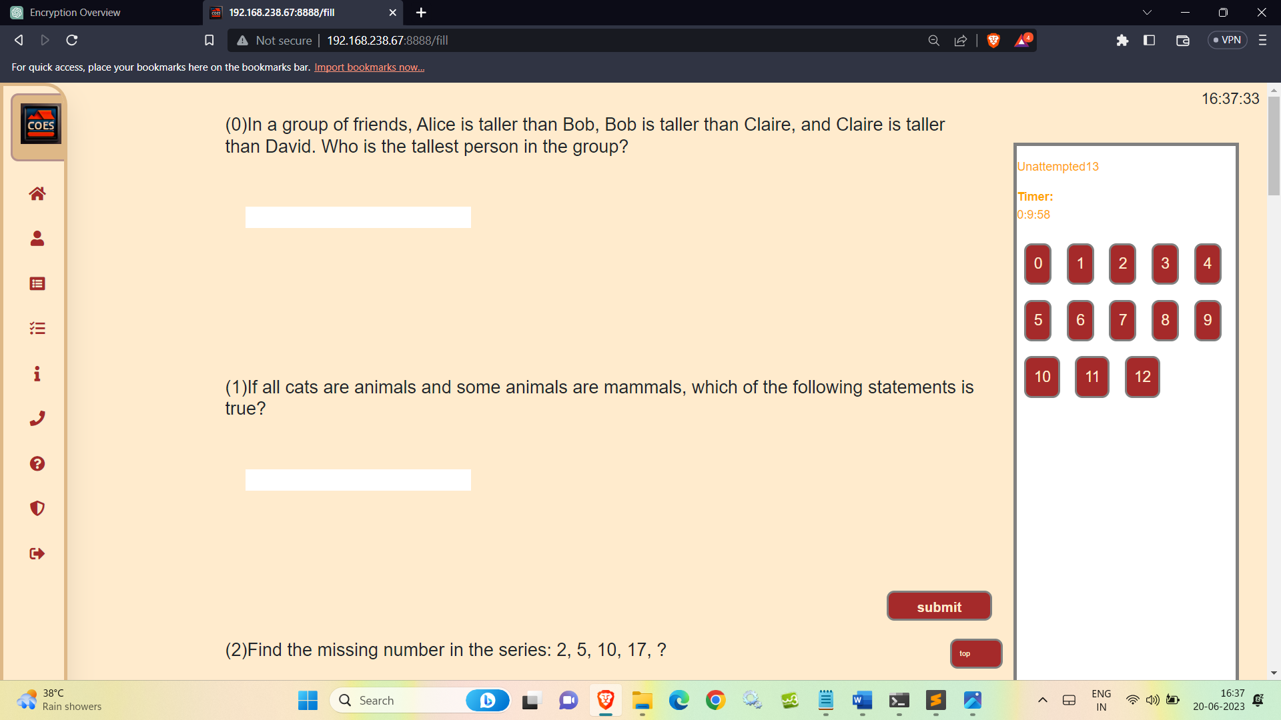

Slide 33
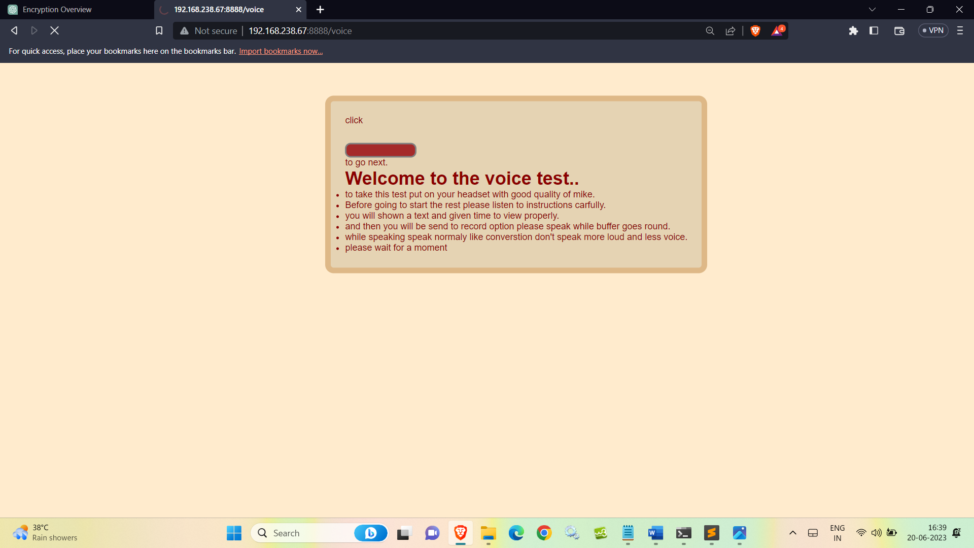

Slide 34
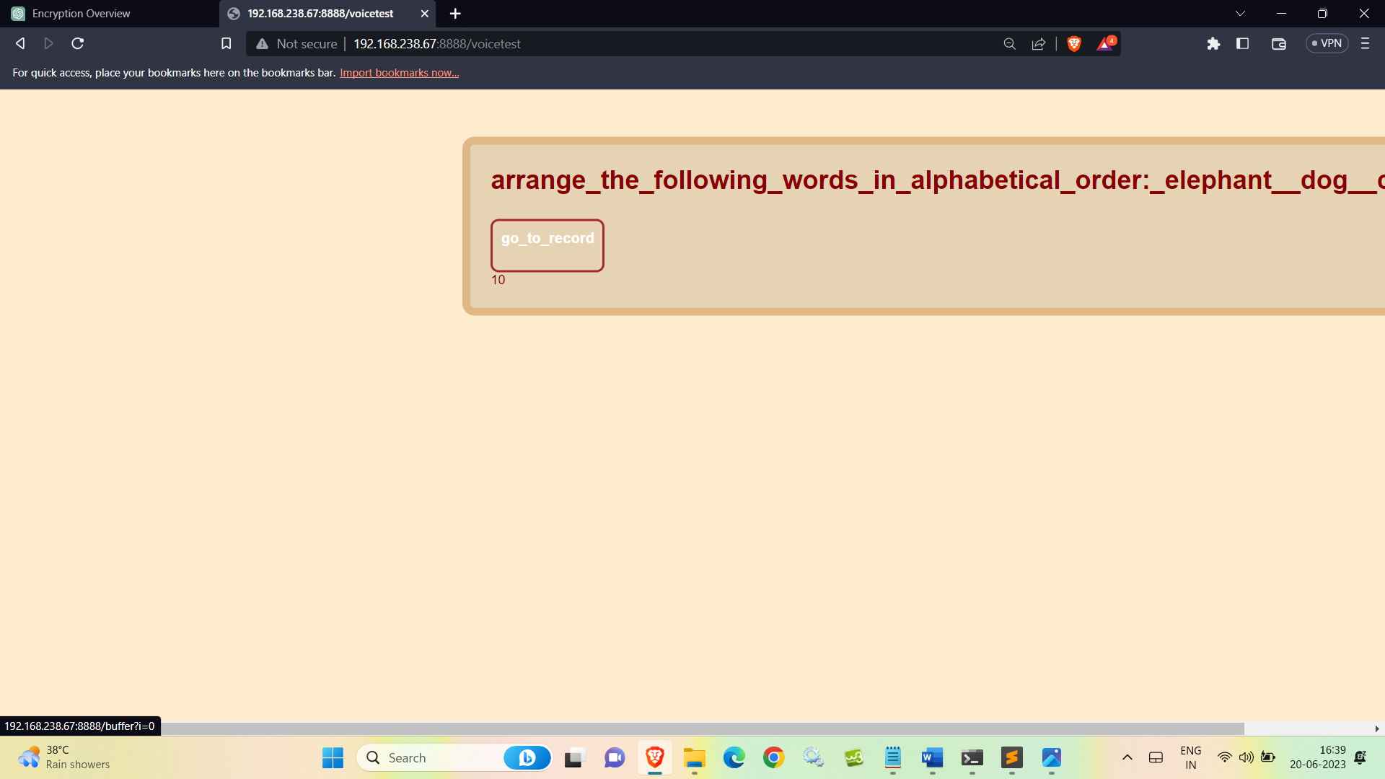

Slide 35
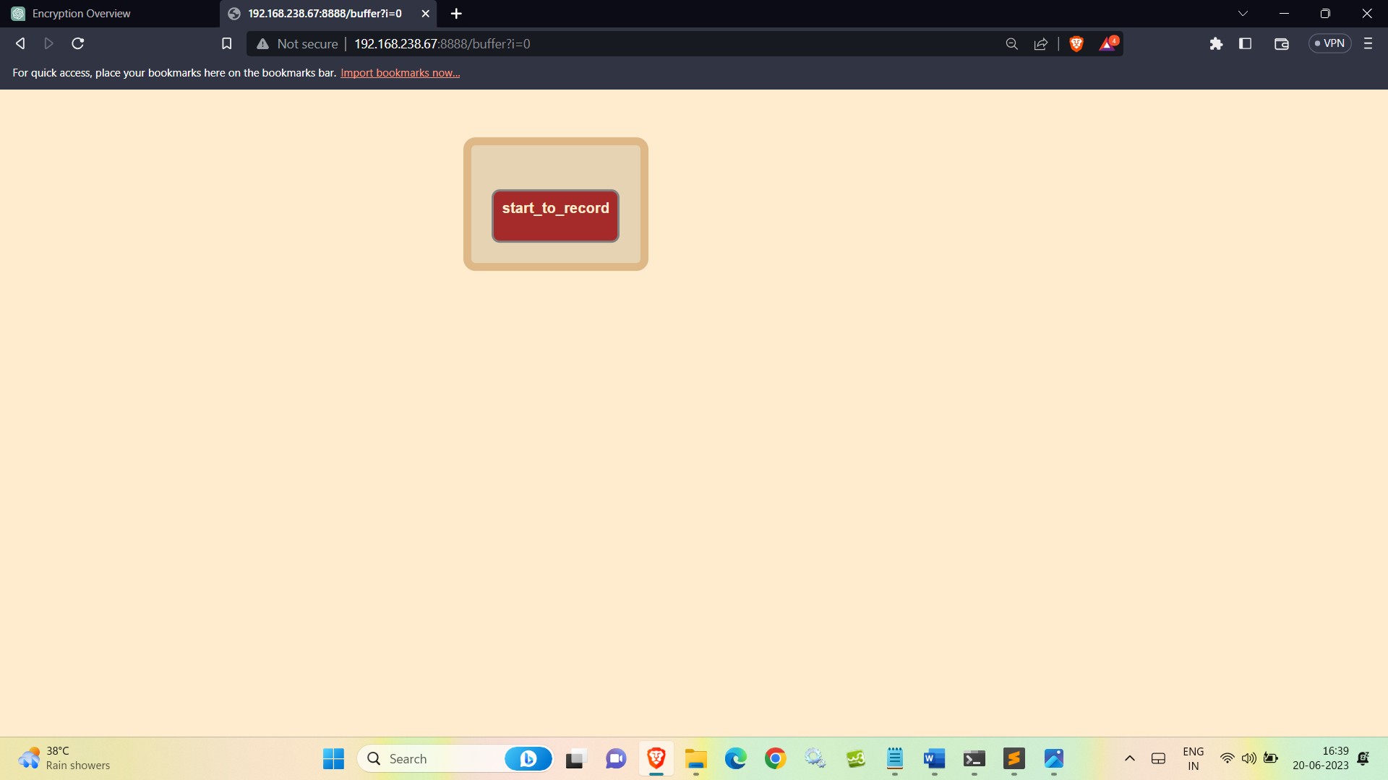

Slide 36
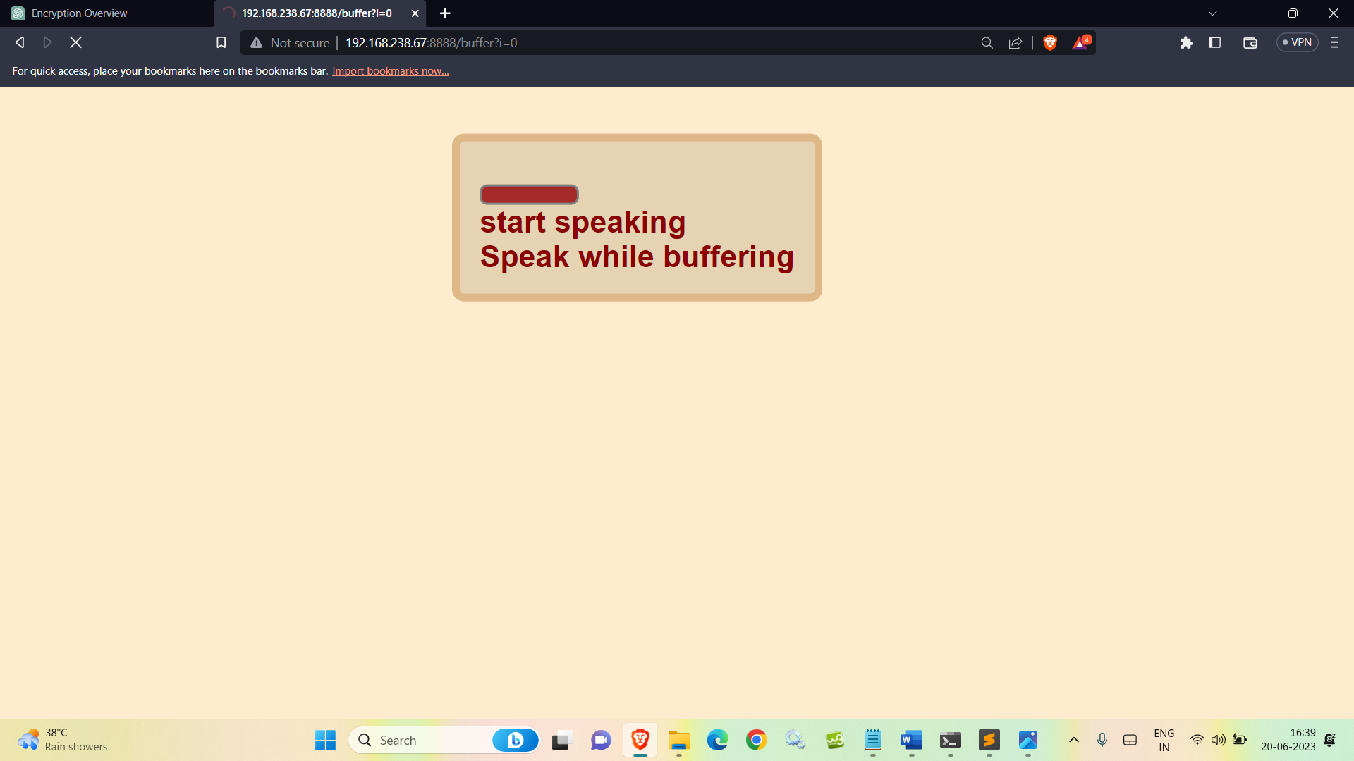

Slide 37
